Slide 1
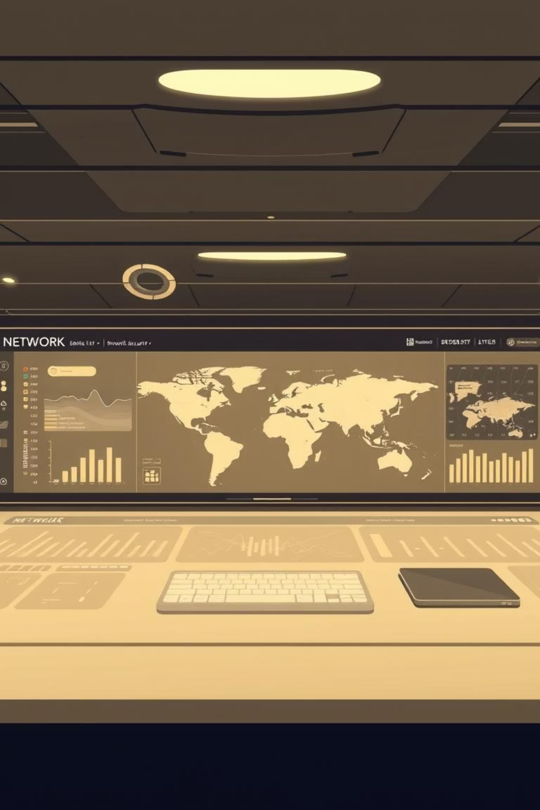
Network Analysis and Monitoring Tool
Professional Traffic Analysis & Real-time Security Mapping
[VISHA HAMEED]
SEMESTER 5A
232201044

Slide 2

Project Introduction: Bridging Security & Visibility
Objective
Our aim is to develop a robust system capable of monitoring, capturing, and visualising network traffic in real-time. This tool will streamline network administration and enhance security posture.
Core Goal
To simplify complex network security and administration tasks through intuitive, visual interfaces, making data-driven decisions accessible and immediate.
The platform is designed as a web-based application, utilising Flask for the backend and Tailwind CSS for a responsive, modern frontend experience.

Slide 3


Key Components: The Three Pillars of Network Insight
Port Scanner
Network Capture
Visualization System
Identifies network vulnerabilities by probing for open ports and services, providing a critical first line of defense.
Enables live packet sniffing and saving of network traffic, offering raw data for in-depth forensic analysis.
Transforms complex network data into digestible maps and charts, providing immediate visual insights into traffic patterns and potential threats.

Slide 4


Module 1: Advanced Port Scanning & Security Assessment
Core Benefit
This module is instrumental in proactively identifying and addressing system weaknesses, safeguarding against potential exploits and unauthorised access.
Multi-threaded Processing
Leveraging multi-threading ensures rapid and efficient scanning across vast network segments, minimising analysis time.
Key Capabilities
Rigorous target IP validation to prevent erroneous scans.
Flexible, customisable port range selection for targeted assessments.
Comprehensive logging of all scanned ports, categorised by open or closed status for thorough review.

Slide 5

Module 2: Real-time Packet Capture & Forensic Analysis
Live Capture
Efficient Data Management
Our system supports real-time sniffing across multiple network interfaces, providing immediate access to live traffic data for proactive monitoring.
Full compatibility with PCAP file format, enabling seamless integration with existing network analysis tools.
Flexible capture limits, allowing users to define duration and size to manage storage and processing resources effectively.
Automated GeoJSON conversion of raw packet data, preparing it for geographical mapping and visual insights.

Slide 6

Module 3: Interactive Visualization for Deeper Insights
Geographical Mapping
Heat Maps
Utilising the Google Maps API, our tool visually plots network connections, showcasing the origin and destination of traffic flows globally.
Dynamic heat maps illustrate traffic density, pinpointing areas of high network load and potential bottlenecks or points of interest.
Protocol Charts
Live Dashboard
Intuitive charts display the distribution of protocols like TCP, UDP, and ICMP, offering a clear overview of network communication types.
An auto-refreshing dashboard provides up-to-the-minute metrics and visualisations, ensuring network administrators have immediate insights.

Slide 7

Technical Implementation: The Robust Tech Stack
Backend Technologies
Frontend Technologies
Networking & Concurrency
Python (Flask): For core application logic and web server.
Tailwind CSS: For a utility-first CSS framework, ensuring responsive and modern UI.
Socket Programming: Facilitates low-level network communication and data handling.
PyShark: A Python wrapper for TShark, enabling packet sniffing.
JavaScript: Powers interactive elements and dynamic data rendering.
Multi-threading: Ensures concurrent operations for efficient scanning and data processing.
GeoIP2: For accurate geographical location tracking of IP addresses.
Chart.js: For generating compelling and customisable data visualisations.

Slide 8

Performance Metrics: Engineered for Efficiency
1400+
High
Optimised
Packets Analysed
Concurrency
Memory Management
Our system demonstrates the capability to analyse over 1400 packets within a mere 30-second window, highlighting its high throughput.
Designed to gracefully handle multiple concurrent user sessions, ensuring consistent performance even under heavy load.
Features highly optimised memory management, crucial for handling large-scale packet captures without compromising system stability.

Slide 9

Security & Operational Benefits: Fortifying Your Network
Enhanced Internal Security
Robust input validation and intelligent rate limiting mechanisms are implemented to prevent tool misuse and maintain system integrity.
Streamlined Operational Efficiency
Automated network monitoring significantly reduces the need for manual intervention, freeing up valuable time for strategic tasks.
Rapid Threat Detection
The system excels at promptly identifying unusual geographical traffic patterns, enabling swift response to potential security breaches.

Slide 10

Conclusion & Future Scope: Evolving for Tomorrow's Threats
Current Success
Future Work & Enhancements
We have successfully developed a robust tool for real-time network traffic assessment and visualisation, providing critical insights for network administrators.
Integration of AI/ML models for advanced, predictive threat detection capabilities.
Development of comprehensive, automated reporting features for simplified compliance and analysis.
"Enhancing Network Visibility for a Safer Digital Environment."

